Slide 1
FACT Bucks AGM
Updates and Issues

Slide 2
Buckinghamshire Council – “the place”
Top 3 Challenges
Demand for services
Budgets
Levelling up

Slide 3
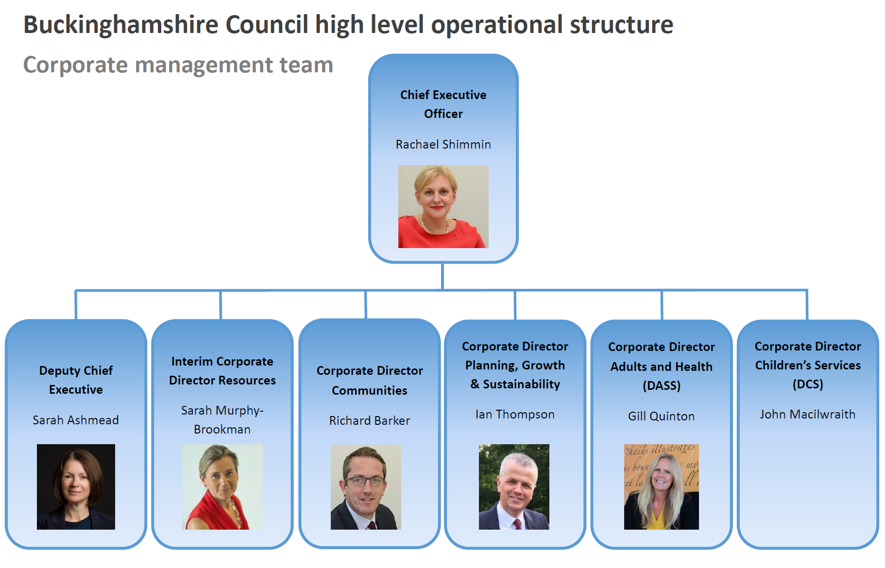

Slide 4
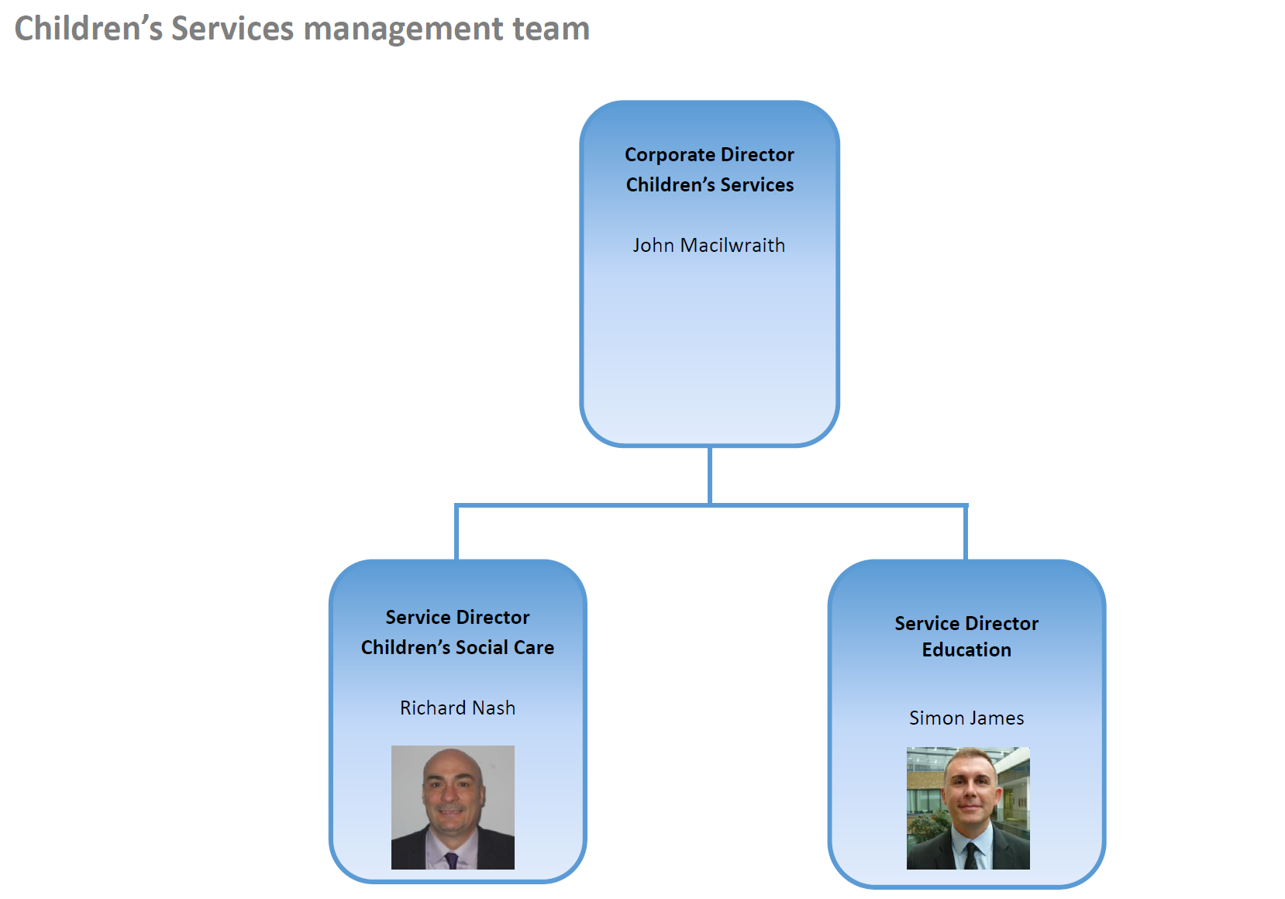

Slide 5
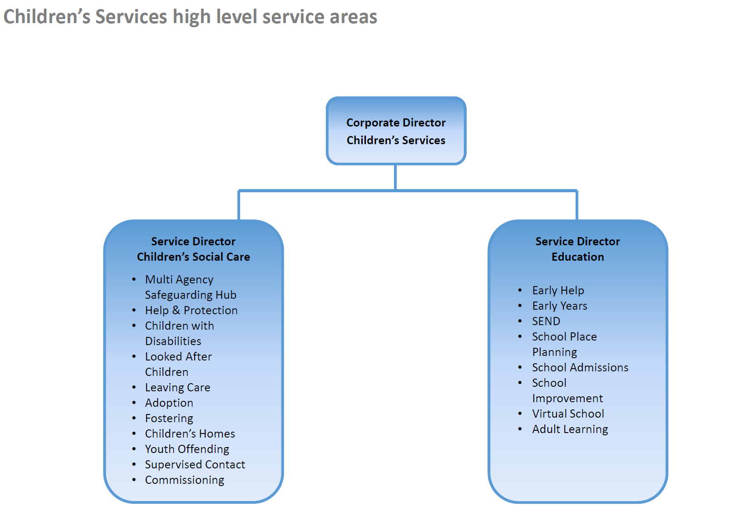

Slide 6


Slide 7
Children’s Social Care
Top 4 Challenges
Increase in number of children needing protection
Increase in the cost of social care placements
Increased cost of agency social workers
Turn over in staffing

Slide 8
Education Services
Top 6 Challenges:
Increase in demand for Education, Health and Care Plans
Consistency in the quality of iSEND staff
Mainstreaming of co-production
Provision of local school places
The “partnership” delivering Early Help
Maintaining Good and Outstanding Schools

Slide 9
Integrated SEND Service – the offer
  Specialist teachers, Educational Psychologists and EHC coordinators are fully coordinated and complement each other, leading to a more joined up and effective approach
  Services more accessible and have a front line presence
  Improved communication: weekly ‘keeping connected’ newsletter to SENCos, Schoolsweb and Local offer information / guidance for schools, families, children and young people
AV
WYC
CSB

Slide 10
Integrated SEND Service – Accessing support
Specialist Teachers – a tiered approach
Increased EHC Coordinator capacity – named link
Educational Psychology offer – named link for schools
Integrated SEND Service training offer

Slide 11
You Said | We Did | We Will Do
24% of parents / carers surveyed recalled being involved in the EHCNA process | Designed a process that includes key communication points and co-production meetings for all EHCNAs | Standardise co-production meetings for all new EHCPs. Gain parental feedback on the review of EHC Needs Assessment portal
41% of parents surveyed said all outcomes written into their EHCPs were written by professionals, without their input | Co-designed a Co-production charter | Embed our Co-production charter, in our strategic and operational work

Slide 12
You Said | We Did | We Will Do
45% of parents / carers surveyed reported that changes had been agreed in the AR but that an amended EHCP was yet to be issued | Published our Annual Review Strategy Set internal KPIs for our EHC Coordinators Track data via SENOPs | Increase compliance across all areas of the Annual Review process Ensure all those pupils in priority 1 have their Annual Review processed by March 2023 Issue over 90% of all Phase Transfer EHC Plans with a named setting by 15th February

Slide 13
You Said | We Did | We Will Do
54% of parents / carers surveyed felt that EHC Coordinators were not good at keeping in touch with families during the EHCNA process | Added additional management capacity with 2 Senior EHCCos in each hub Continued to allocate workload to EHCCos in terms of type of work, not just by numbers Increase staffing capacity with our iSEND Support Officer staff (admin) | Re-implement our co-production meetings for 20 week plans Decrease wait times on our phone lines

Slide 14
You Said | We Did | We Will Do
77% of parents / carers surveyed had never used the Local Offer | Co-designed ‘new’ Local Offer – launched Nov 20. Developed SEND pages on schoolsweb – July 20. Trained iSEND staff on the new platform Developed with special schools specific pages to show in a simple format continuum of specialist provision in Bucks to enable parents / carers to use this resource to make choices Local Offer reference is on al iSEND professionals’ signatures | Embedding Local Offer training for schools into iSEND free training offer Raise the profile with all – at highest levels too (e.g. Select Committee) Promote in everyday interactions with families

Slide 15
You Said | We Did | We Will Do
77% of parents / carers surveyed had never used the Local Offer | Co-designed ‘new’ Local Offer – launched Nov 20. Developed SEND pages on schoolsweb – July 20. Trained iSEND staff on the new platform Developed with special schools specific pages to show in a simple format continuum of specialist provision in Bucks to enable parents / carers to use this resource to make choices Local Offer reference is on al iSEND professionals’ signatures | Embedding Local Offer training for schools into iSEND free training offer Raise the profile with all – at highest levels too (e.g. Select Committee) Promote in everyday interactions with families

Slide 16
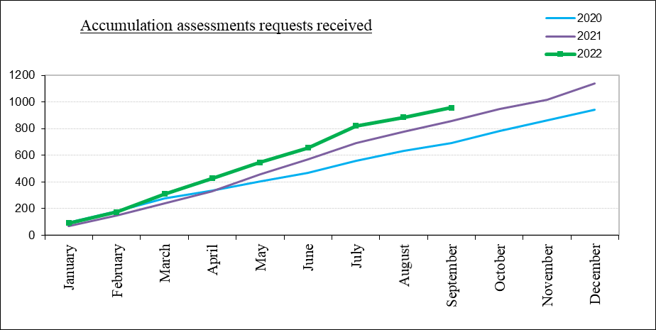
Integrated SEND Service-Requests for EHC need assessments and Decisions to Assess
956 requests for EHC needs assessment have been received during September 2022. This is an increase of 12% from 2021 and an increase compared with 2020 of 38%.
National figures show that the number of requests for assessment during 2021 was 24% higher than in 2020.

Slide 17
Integrated SEND Service-Requests for EHC need assessments and Decisions to Assess
 | Agreed | Not Agreed | Total | % Agreed
Setting Request | 442 | 203 | 645 | 69%
Parental Request | 158 | 174 | 332 | 48%
Parental Request (Resubmission) | 14 | 0 | 14 | 100%
YP Request | 0 | 0 | 0 | -
Total | 614 | 377 | 900 | 62%
During 2022, there have been 991 requests for EHC needs assessment for which decisions have been made. 62% of these requests have been agreed and 80% of the decisions on assessment have been made within 6 weeks.
Nationally for 2021 the % of requests agreed stood at 78%, and for the south-eastern region 74%. This is higher than the Bucks 2021 figure of 68%.

Slide 18
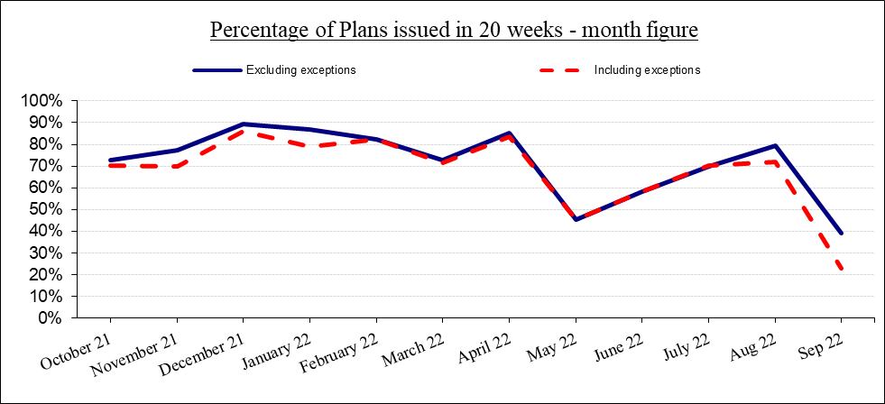
Integrated SEND Service- EHC Needs Assessments
20-week Statutory timescale for EHC Plans
During September, 101 final plans were issued. Of these, 23 were issued within 20 weeks (22.8%). For 2022, 60.5% of all plans have been issued within 20 weeks, rising to 67.1% for plans excluding exceptions.
Hub compliance
  Aylesbury -49.5%
  Chiltern and South Bucks – 60.7%
  Wycombe – 95.4%
National figures for statutory 20 week compliance for 2021 was 59.9% with south-eastern region being 49.3%. For 2021, 78.6% of final plans were issued within 20 weeks and 82% for plans excluding exceptions, exceeding the national average.

Slide 19
Integrated SEND Service- Annual Reviews
What are the outcomes we want to achieve with the 2022 Annual Review Strategy?
Annual review meetings are held at least annually consistently.
Decisions to amend and subsequent amendments to EHCPs are achieved in a timely way.
Quality of those amended EHCPs are good / we have an awareness of the issues and are working to address these through the QA lead.
Appendices are received in a timely / quality way to enable education, health and care advice to be added in.
EHCPs are ceased in a timely way (impacts resources, numbers of EHCPs used for projections and other key factors)
Reduced complaints and tribunals in relation to ARs / placements.
Preparation for adulthood focus; we are working with specific special schools on quality and PfA as part of ARs as a pilot in early 2022.
2022 Area Summary
 |  | AV | CSB | WYC
Number of AR meetings |  | 1089 | 1401 | 1119
AR meetings held within timescale |  | 52% | 33% | 50%
Decision notification within 4 weeks |  | 19% | 34% | 48%
Number of PAPs |  | 359 | 421 | 738
Number of FAPS |  | 315 | 485 | 1285
FAPs within12 weeks of meeting date |  | 18% | 18% | 30%

Slide 20
Integrated SEND Service- Annual Review Strategy
Priority 1: Vulnerable Groups
Priority 2: Phase Transfers
Priority 3: Overdue for 2 years or more
Priority 4: Under 5s
Priority 5: Those where timeliness can be met
Priority 6: Tracking progress towards outcomes / ceasing of EHCPs

Slide 21
Integrated SEND Service
What’s working well:
20 week compliance in the Wycombe hub Our EP and Specialist Teacher reports are consistently being graded good or better through our Quality Assurance process Compliance with ‘school age’ Phase Transfer process Multi-agency support at our iSEND Placement Panel Therapist attendance at our iSEND Surgery (decision making panel for EHC Needs Assessments) Weekly ‘iSEND Newsletter’ to Bucks settings

Slide 22
Integrated SEND Service
What are we worried about: | What are our next steps:
Consistency of 20 week compliance across the iSEND Service | Embedding EP allocation agreement Increased Senior Management oversight, including weekly reporting Additional Training to Senior Leadership Team Peer Mentoring
Compliance with Annual Review timescales | Embedding the Annual Review Strategy Increased Senior Management oversight, including weekly reporting
A consistent SEN Support offer in all settings | Embedding the SEN Support Toolkit Setting Audits by our SEND Inclusion Advisors Training to settings

Slide 23
Integrated SEND Service
What are we worried about: | What are our next steps:
Communication | Re-introduce the FACT Bucks/iSEND Service meet the team termly sessions Re-implement our co-production meetings for 20 week plans Decrease wait times on our phone lines Implementing our iSEND Communication policy with all settings Hold our Annual ‘Shout out to SEND conference
Staff retention (EHC Coordinators) | Embedding our enhanced Induction Programme Learning from ‘exit interviews’
Our Preparing for Adulthood Offer (PfA) | Publish our PfA Toolkit Complete a gap analysis

Slide 24
SEND Improvement
What’s going well?
  Refreshed improvement programme based on 5 key priorities:
    Early identification and intervention
    Preparation for adulthood
    Annual Reviews
    Vulnerable children
    Outcomes
  The quality of new EHCPs is improving – more comprehensive and holistic plans are being produced
  Improved reporting of outcomes is under development to show progress
What are we worried about?
  Numbers of young people with SEND who become NEET/lack of local post 16 options
  The join up of education and housing options for post 19
  The number of existing EHCPs that need to be thoroughly updated following annual review to ensure they reflect the child or young persons needs
  Waiting times for health services
What are the key next steps
  Publish transition guide for families
  Resume quality assurance of existing EHCPs that have been through Annual Review to support further improvement
  Increase direct engagement with parents/carers to support improvement
  Co-production event happening in the Autumn
  Consult on an Buckinghamshire All-Age Autism strategy

Slide 25
SEND Improvement: Written Statement of Action (WSoA)
The WSoA identified 3 areas of significant concern:
  The lack of a cohesive area strategy to identify and meet the needs of those children and young people requiring speech and language, communication and occupational therapy
  Waiting times for assessments on the autism and attention deficit and hyperactivity disorder diagnosis pathways and the system-owned plans in place to address this
  Waiting times to see a community paediatrician.
What’s going well?
  The spotlight on health/waiting times has enabled a renewed focus on critical areas
  Strengthened relationships with health – platforms to work together/challenge
  New parent dialogue groups are emerging to inform improvements and assess if actions are leading to change
  A co-produced Therapies Strategy will be going out to consultation in November
  Digital assessments for children with less complex presentations of autism are increasing with 25 completed in quarter 1, in line with expectations.
  A toolkit to support school avoiders is in the final stages of development
  Early indications suggest a pre-assessment support pilot (Autism pathway) is having a positive impact on children and families
  The waiting time for EHCP advice from community paediatricians has reduced (average 9 weeks in Sept compared to 27 previously)
  Additional posts have been recruited (prescribing pharmacists, GPs with an interest in neuro)
  Pre diagnostic support (equine therapy) has been popular (227 children engaged)
What are we worried about?
  Funding to enable change
  National shortage across professions i.e. therapists and community paediatricians, including capacity of outsourced provider to deliver
  The pace of change
What are the key next steps
  4 workshops taking place Nov – Feb to focus on key issues (commissioning, communication, early intervention and pathways)
  First monitoring meeting with DfE in December to assess progress

Slide 26
Sufficiency of educational placements
The SEND Education Sufficiency Strategy 2022-27 was published in Jan 2022; phased approach to creating more education places to meet needs locally
GD000712_SEND_Education_Sufficiency_Strategy_v5_web.pdf (buckinghamshire-gov-uk.s3.amazonaws.com)
Phase 1
Sept 2022
  5 places at Princes Risborough Secondary School Communication and Interaction (Autism) Unit.
  3 places at Holmer Green Senior School ARP
  8 places (year 7) in new SEMH Inclusion Unit at Kingsbrook School (32 over time)
  12 places at Stocklake Park Secondary Special School
  9 places at Westfield Primary Special School
May 2023
  2 new classrooms at Furzedown Special School to accommodate 15 existing pupils
Sept 2023
  Aiming to relocate post 16 provision to a satellite site to enable more places at Furzedown School
Sept 2024
  2 x 12 place primary SEMH inclusion units (Wycombe and Aylesbury)
  2 x 12 place primary communication and interaction (Autism) inclusion units at 2 mainstream schools in the Aylesbury Vale area
  1 x 18 place secondary communication and interaction (Autism) inclusion unit at a school in the Aylesbury Vale area
Phase 2
A bid has been submitted (Oct 2022) to open a new free school to cater for children with SEMH needs aged 7 – 19. This would create 48 new places in year 1, increasing to 152 within 5 years.

Slide 27
References
SEND Local Offer
One stop shop for families and professionals for all things SEND
Buckinghamshire SEND Local Offer
SEND Schoolsweb
One stop shop for schools and professionals for all things SEND
SEND and Inclusion | SchoolsWeb (buckscc.gov.uk)
The iSEND Area Hub pages give a variety of information specific to your area:
Aylesbury | SchoolsWeb (buckscc.gov.uk)
Chiltern and South Bucks | SchoolsWeb (buckscc.gov.uk)
Wycombe | SchoolsWeb (buckscc.gov.uk)
Education, Health and Care Plans – Support
EHC Coordinators

